Slide 1
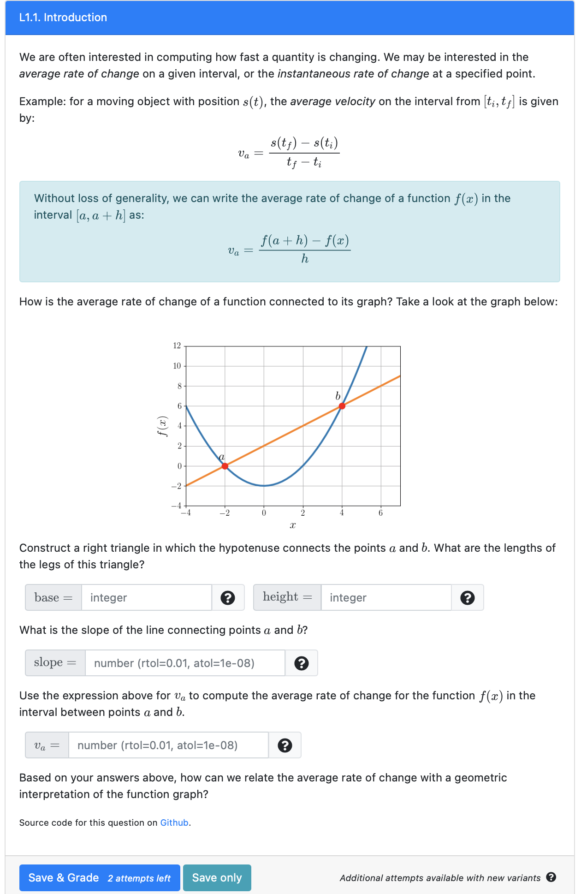
Text (html or markdown) and equations using Latex
Figures (this plot is dynamically generated using python library, but one can also include static images)
PrairieLearn elements
Two attempts for each question variant (where the parameters of the plot are fixed)

Slide 2
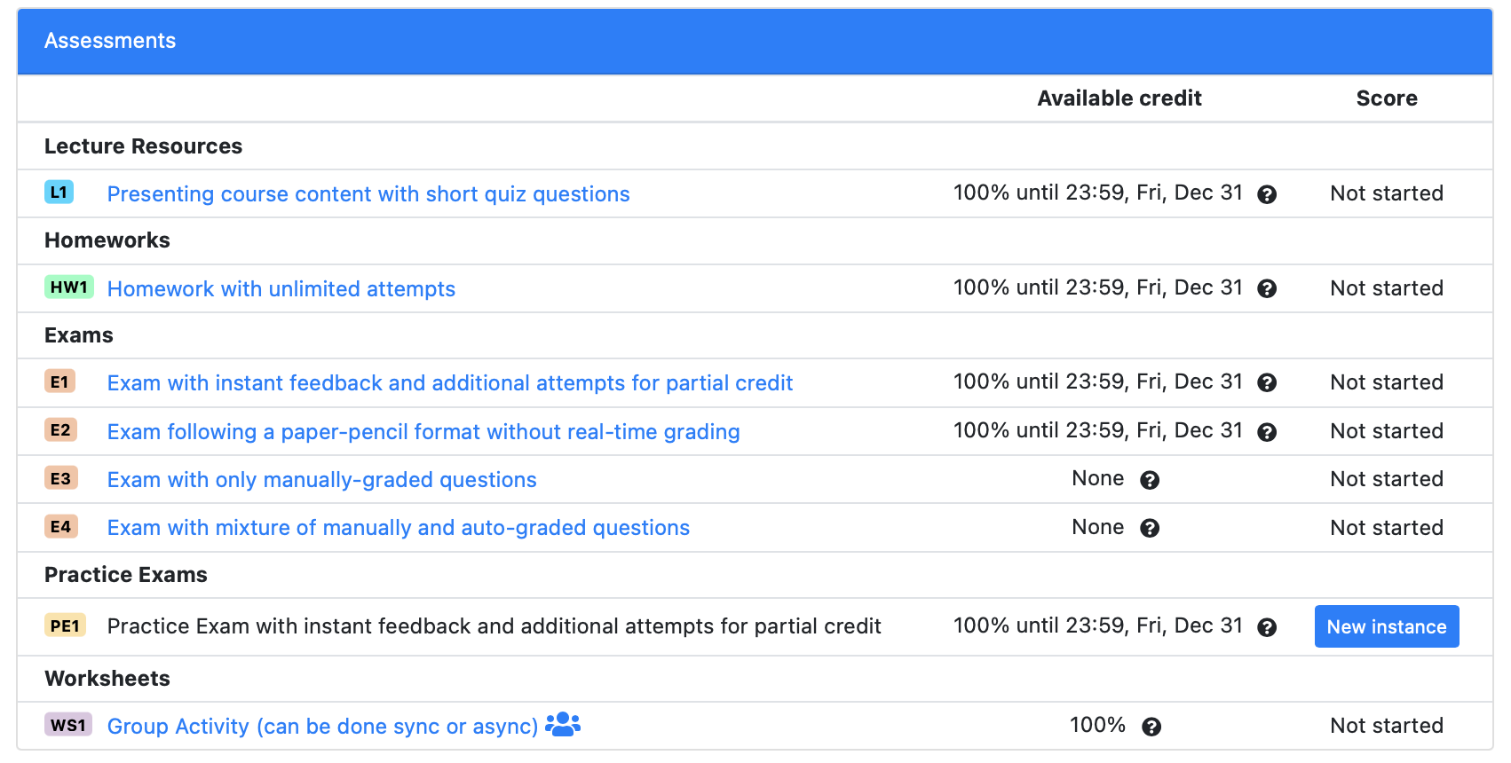

Slide 3
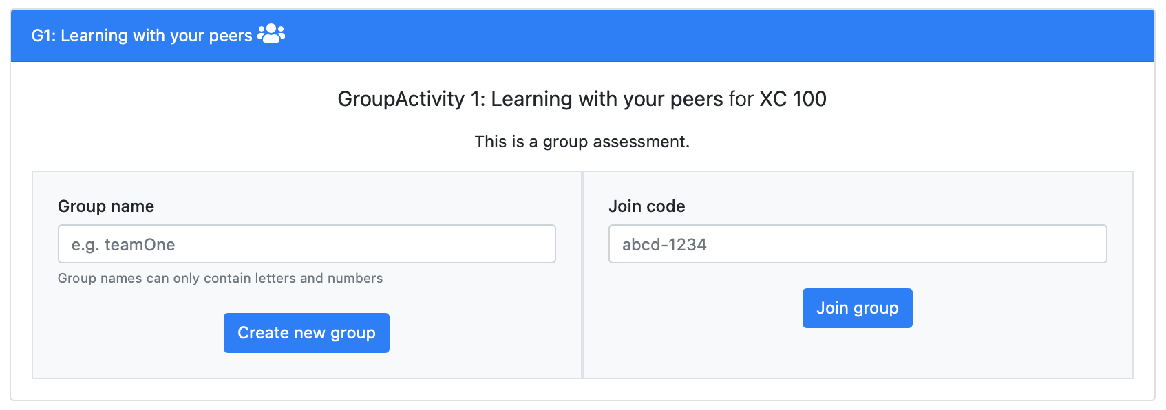
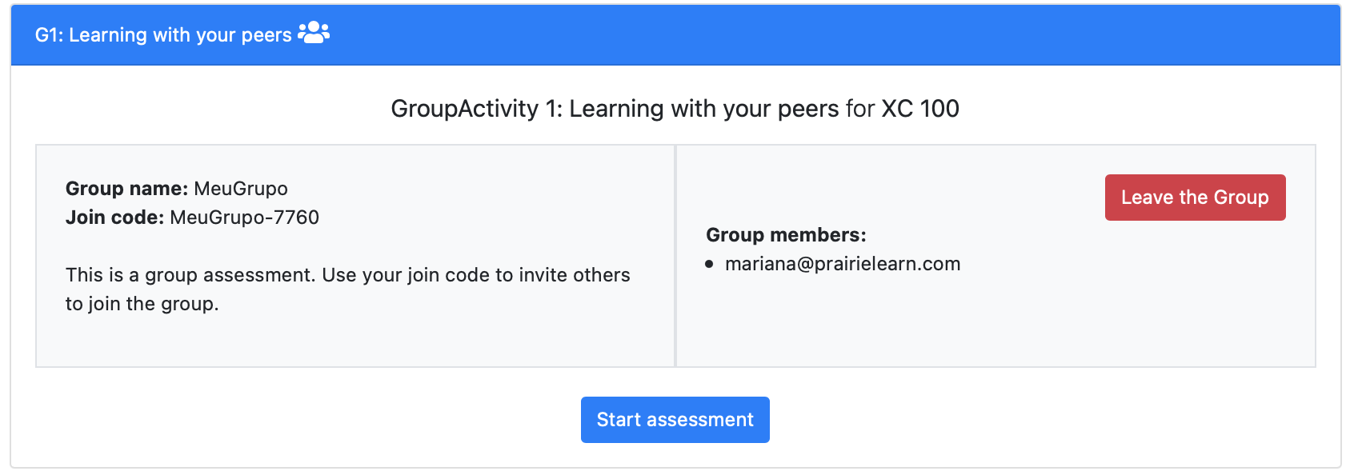

mariana@prairielearn.com creates a group with name “MeuGrupo”
mariana@prairielearn.com receives a Join code to invite others
matt@prairielearn.com uses the Join code ”MeuGrupo-7760” to join ”MeuGrupo”
They can start now the same assessment (sharing questions and scores)

Slide 4
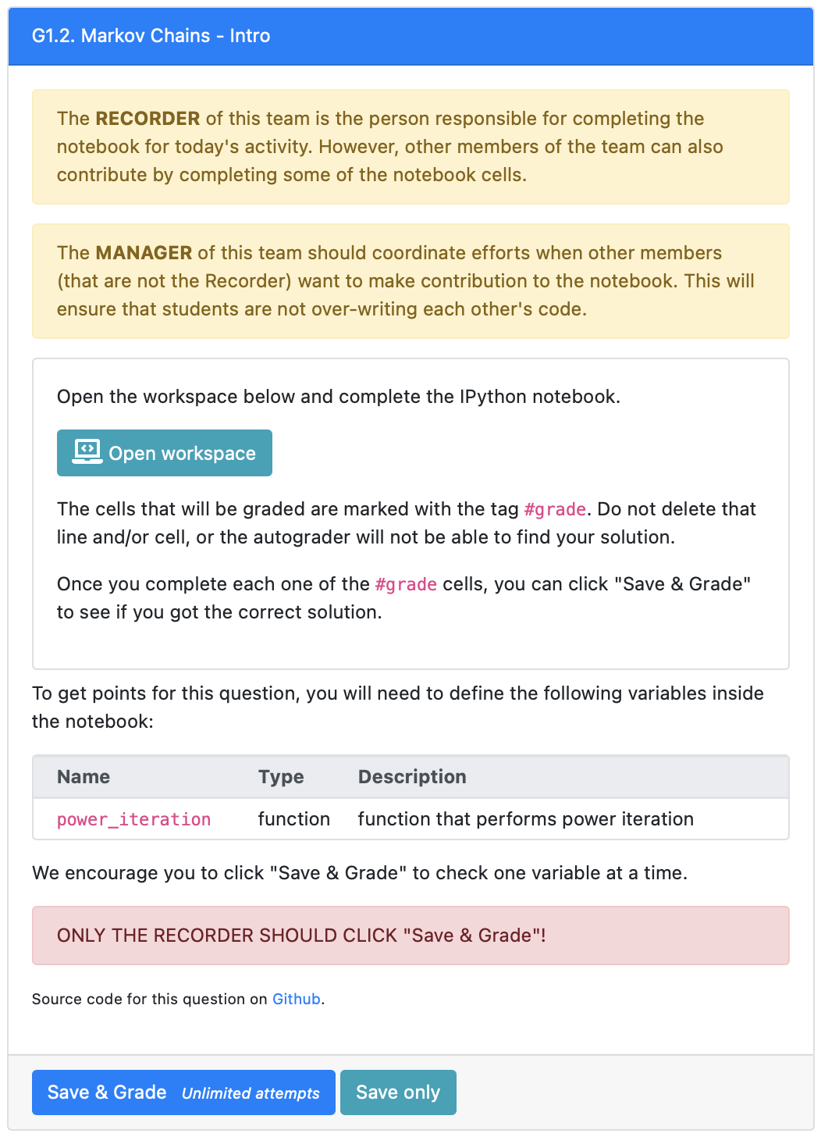
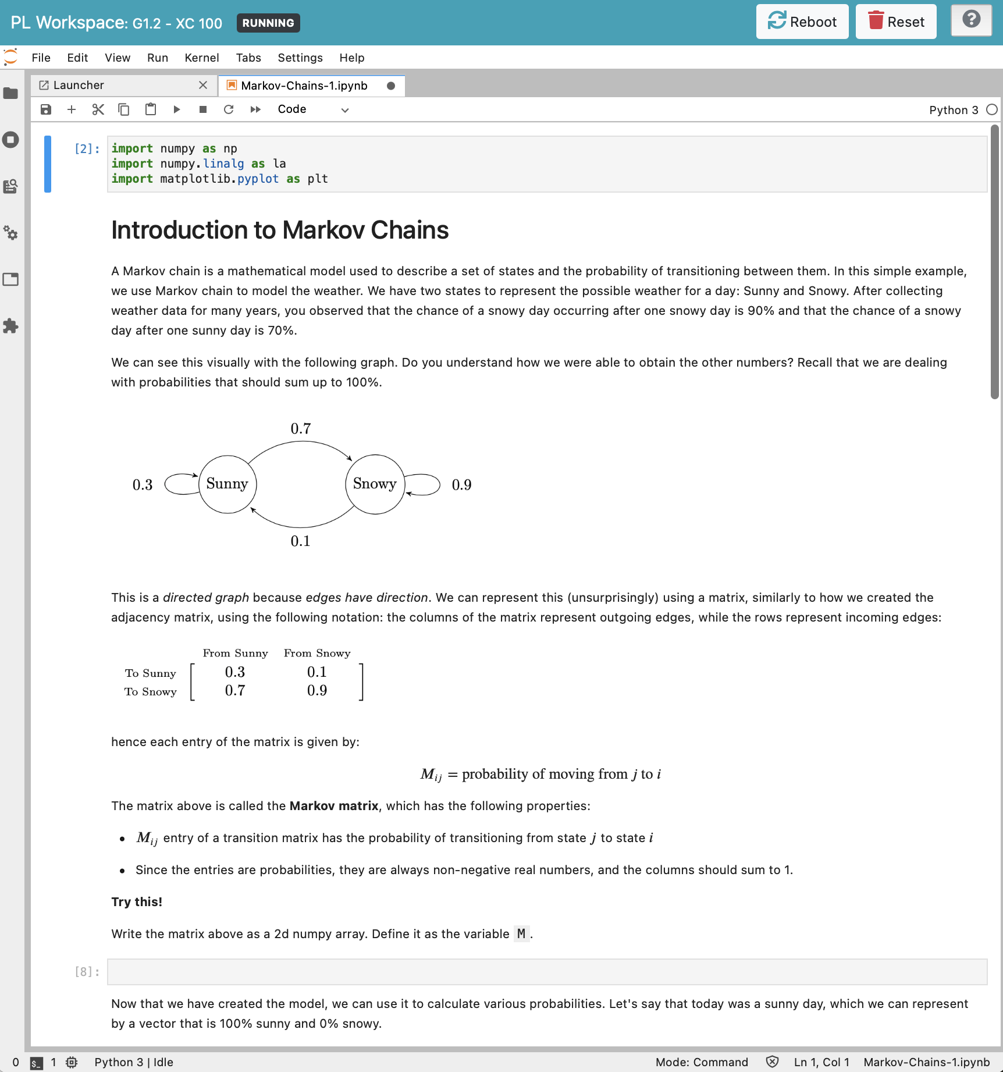
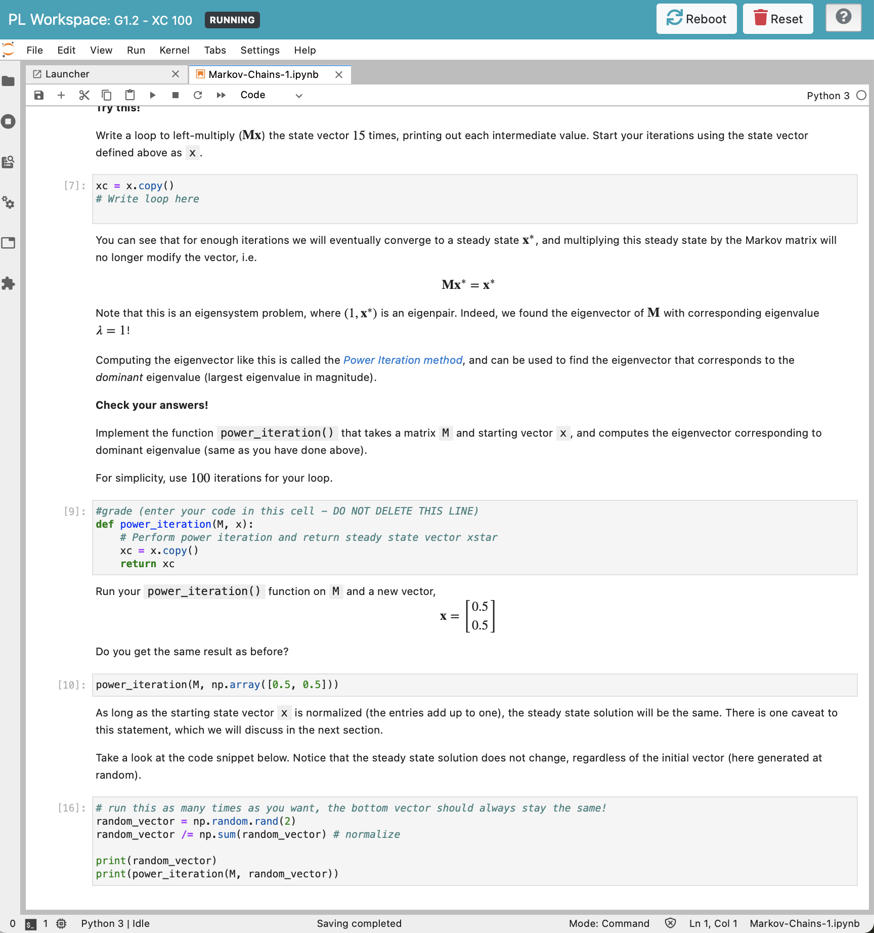
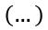


Opens JupyterLab
$$⋮$$
$$\left(…\right)$$
$$⋮$$
Complete code in this #grade cell to receive feedback and/or points
Students can submit unlimited attempts to receive feedback without getting penalized

Slide 5


Slide 6
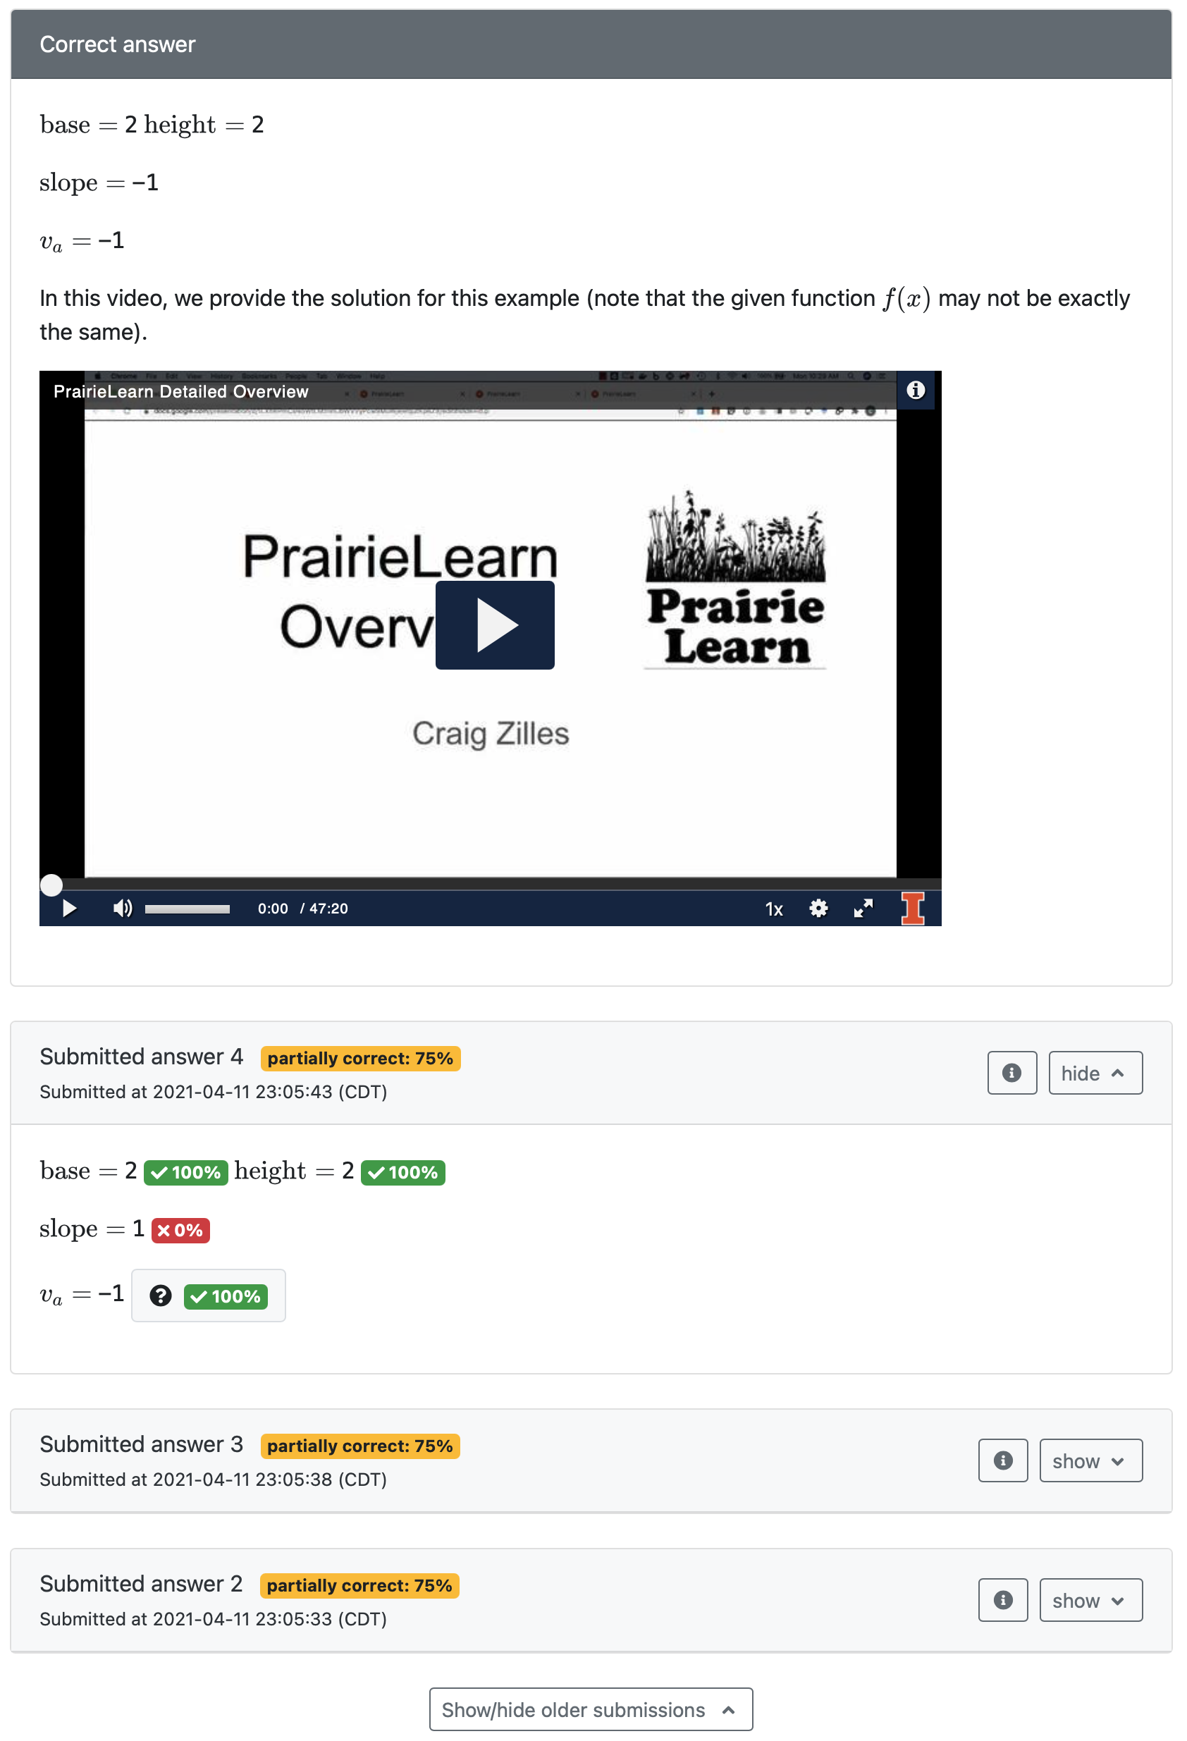
Correct answer is only displayed after all attempts for the variant are used, or the question is answered correctly. In this example, we embed a short video explaining the solution
Log of all submissions

Slide 7
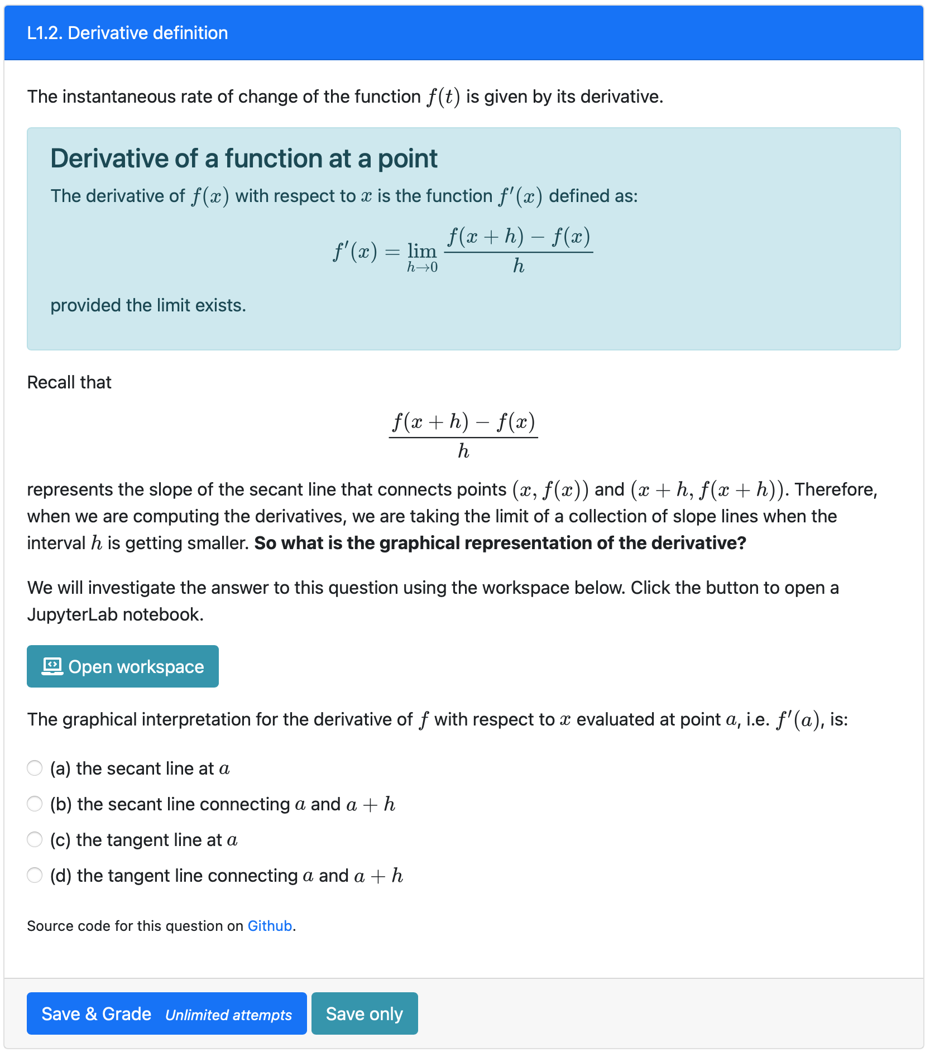
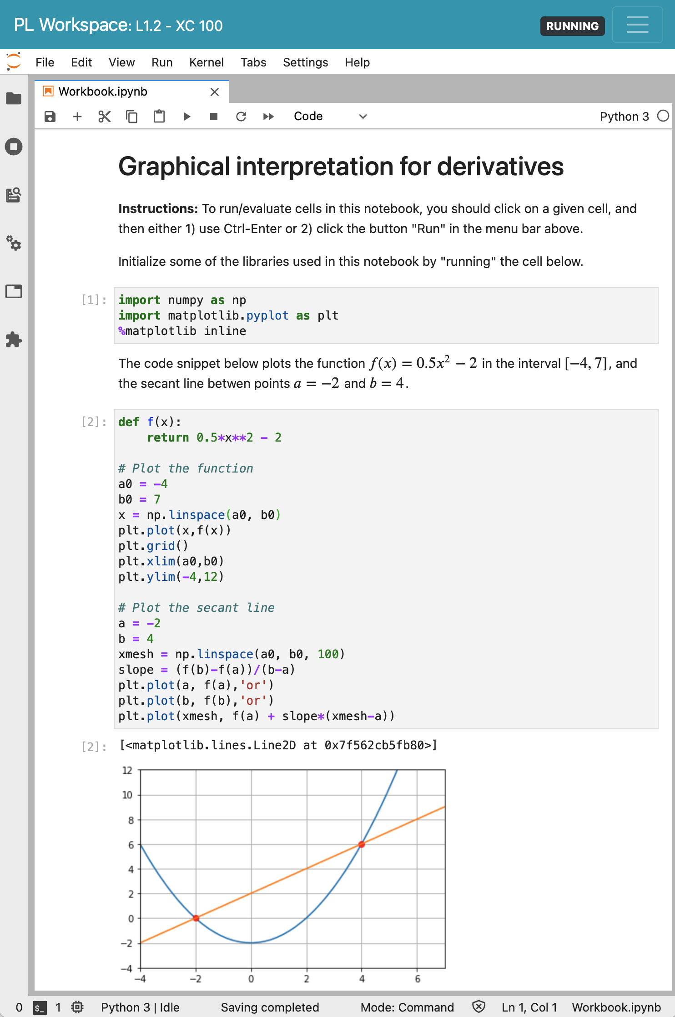
Opens JupyterLab
PrairieLearn element

Slide 8
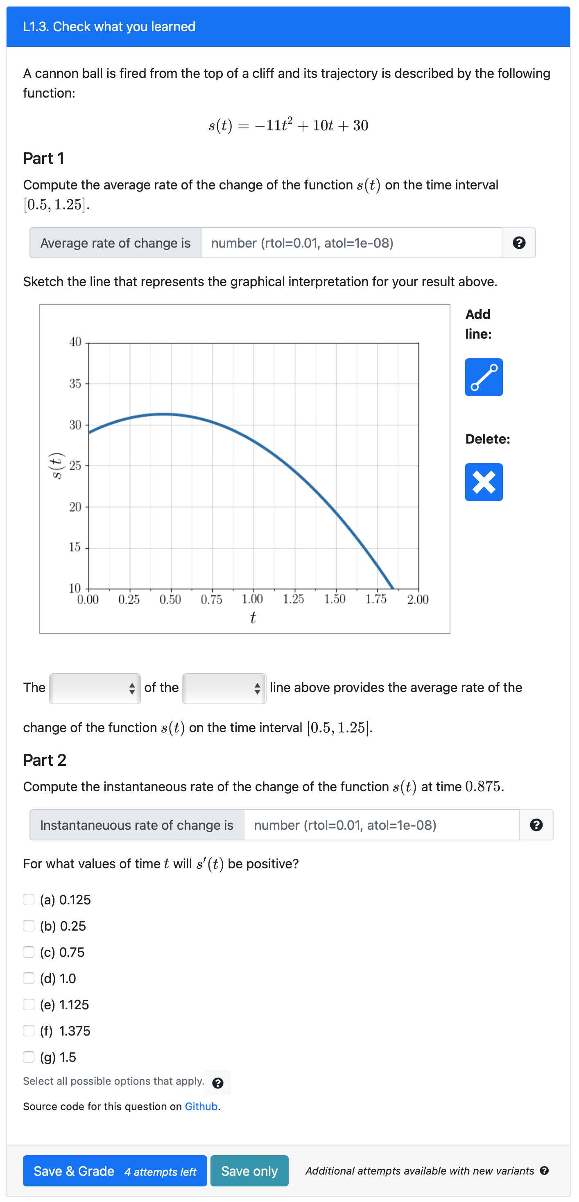
These parameters are randomized for each question variant
Number input
Sketch input
Plot is dynamically generated based on the parameters above.
Dropdown input
Number input
These parameters are randomized for each question variant
Checkbox input

Slide 9
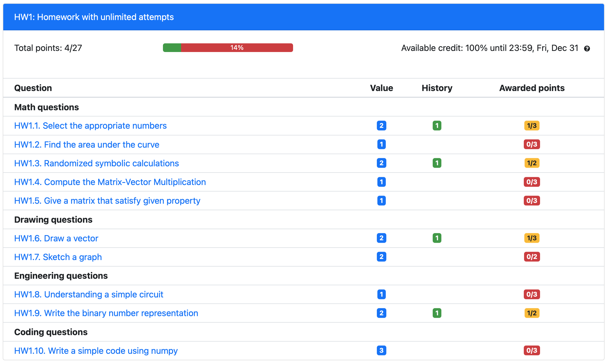
Checkbox input

Slide 10
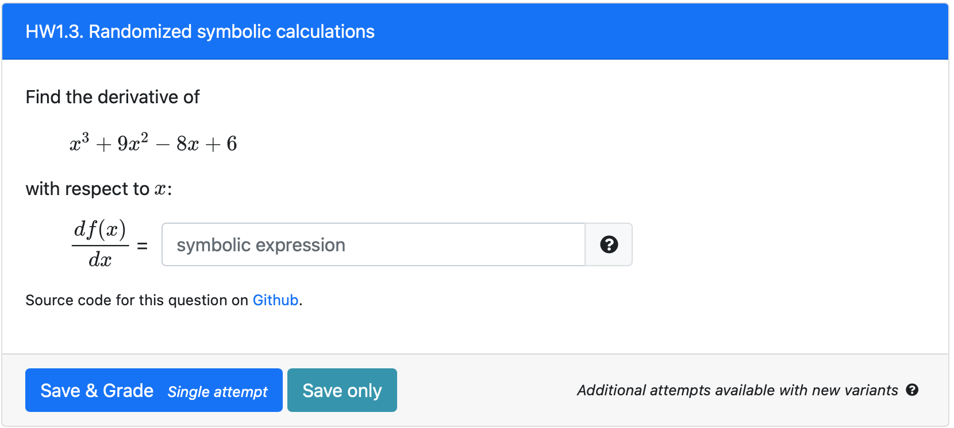
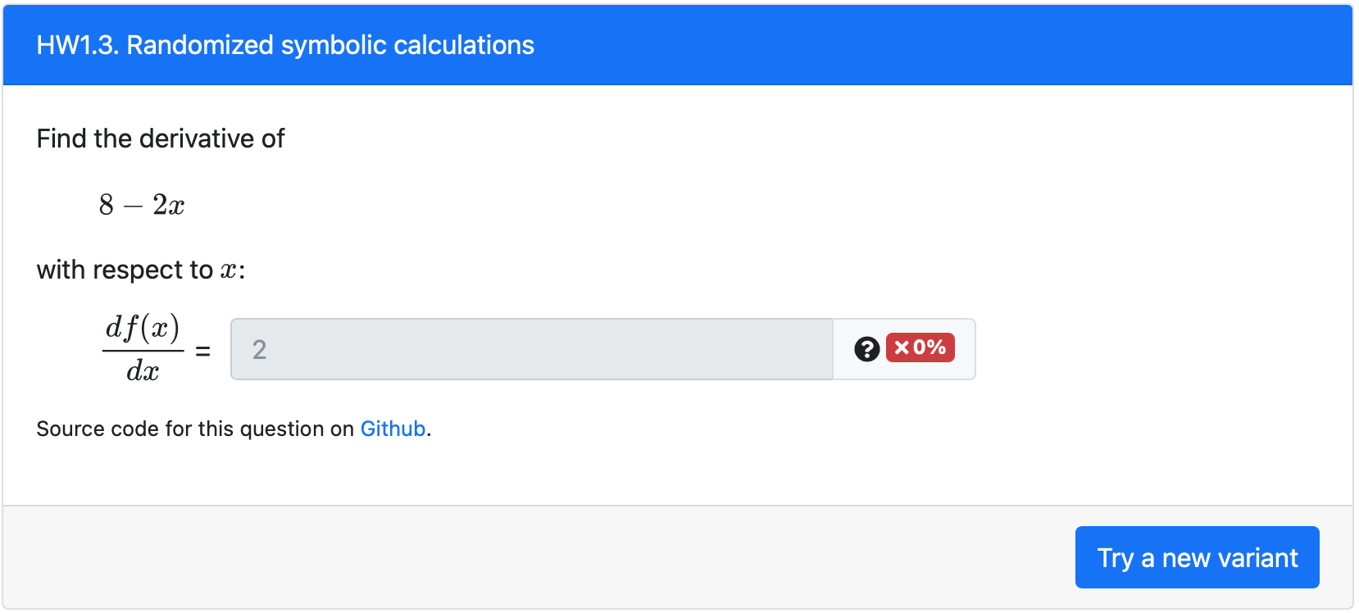
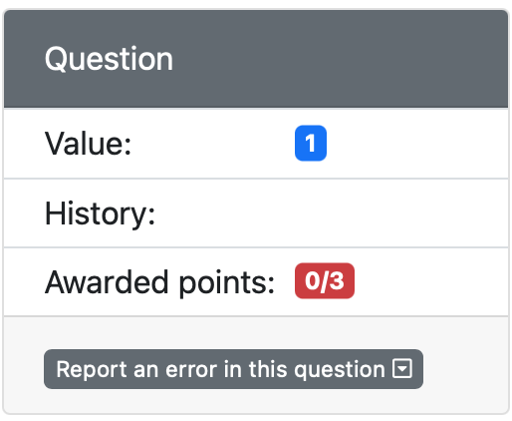
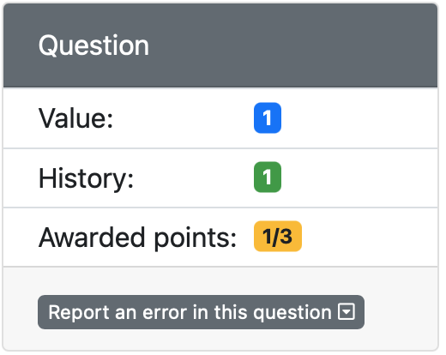
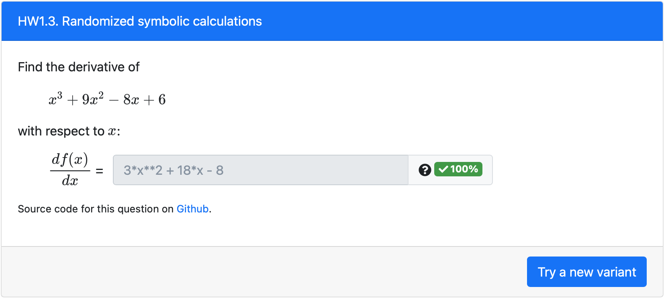
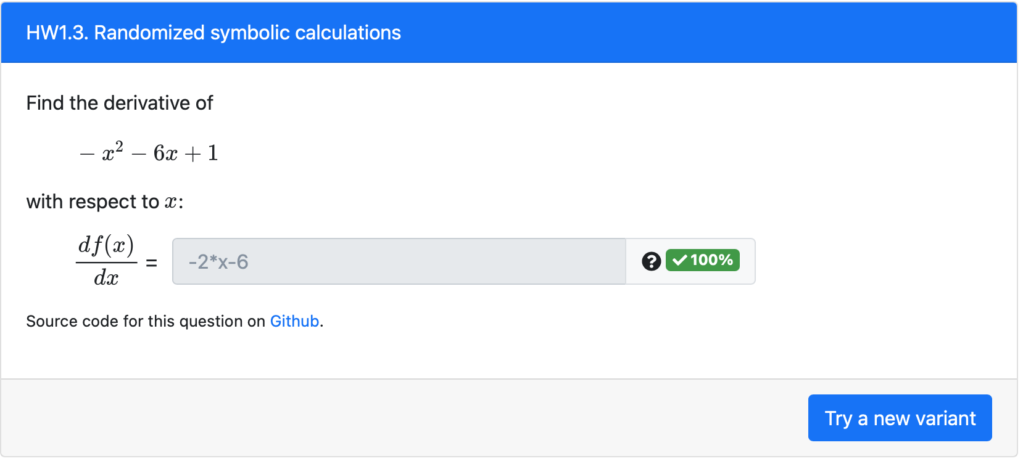

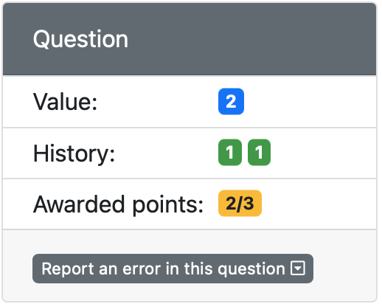
Fig. A) Initial configuration
Fig. C) After 2nd attempt
points
maxPoints
Fig. B) After 1st attempt
Fig. D) After 3rd attempt

Slide 11
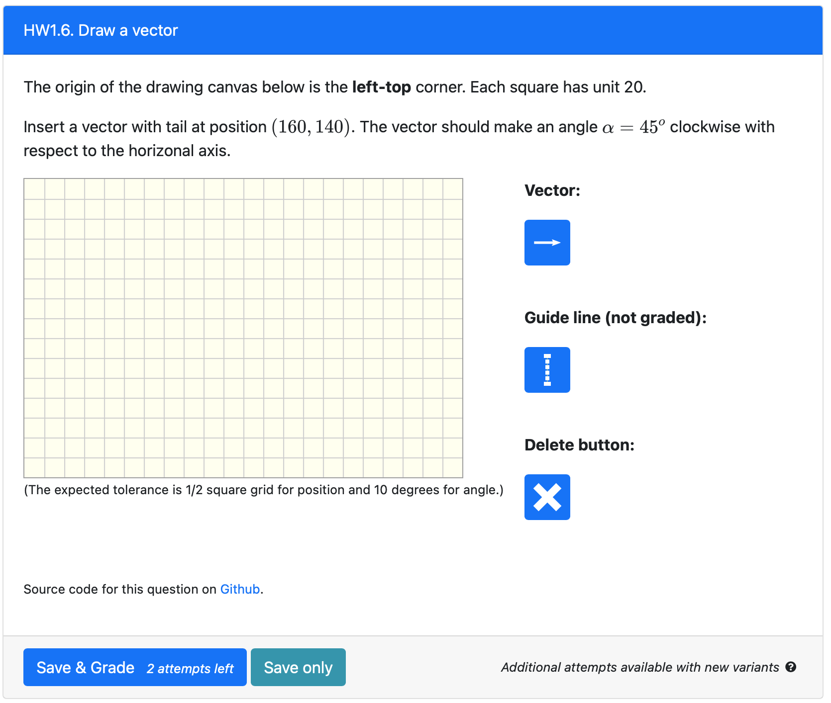
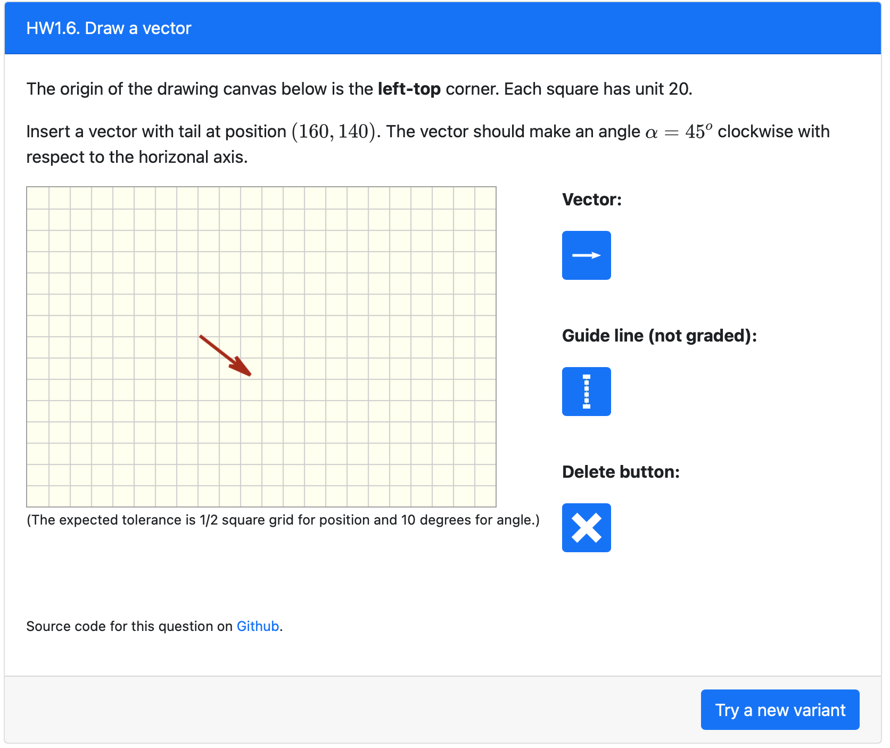
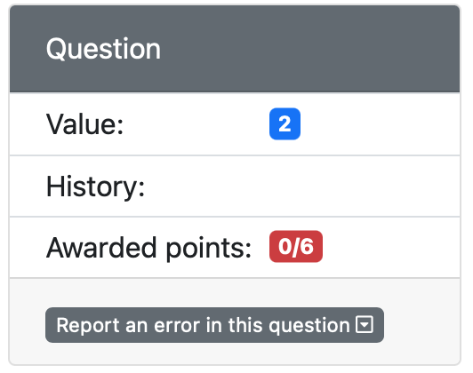
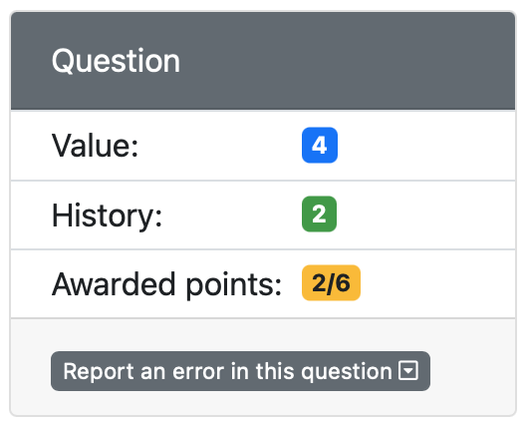
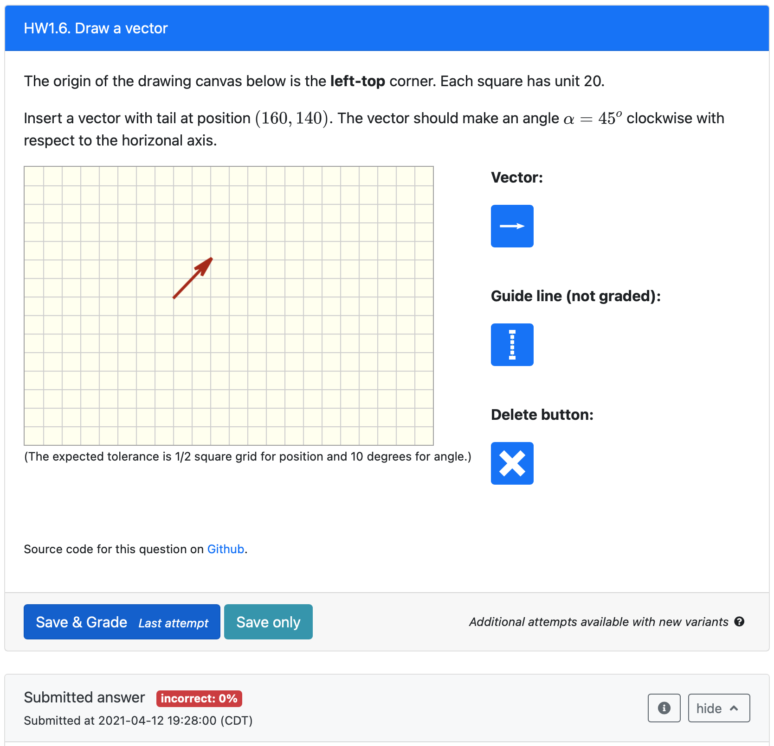

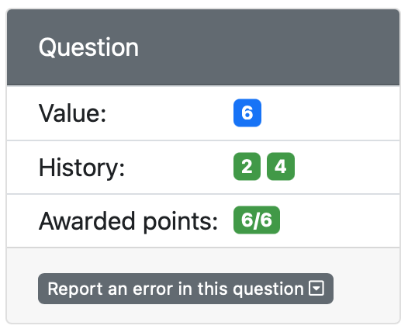
2nd attempt
This is the same question variant, but now with the correct submission
1st attempt
3rd attempt
Incorrect submission (angle should be clockwise).
Another question variant with correct submission
Student can still try another attempt of the same question (in this case, just rotate the vector)

Slide 12
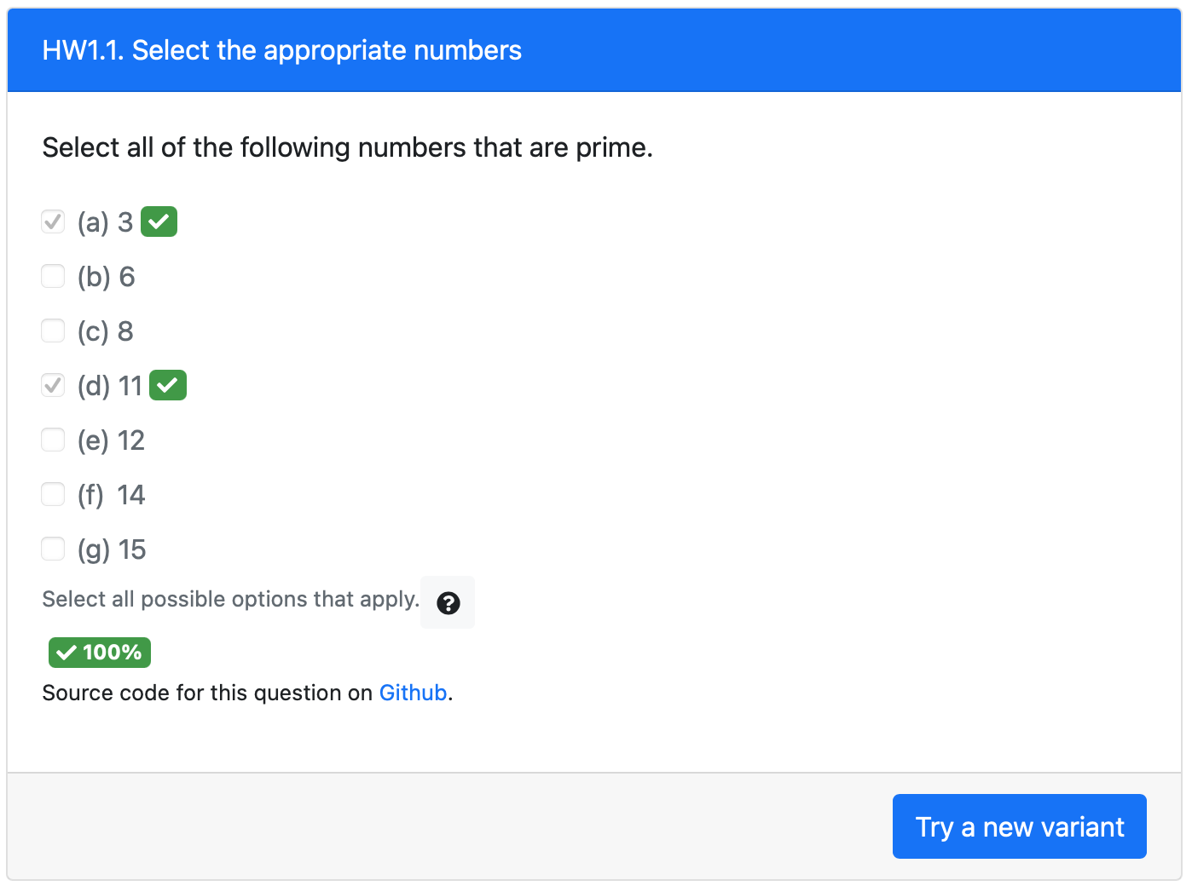
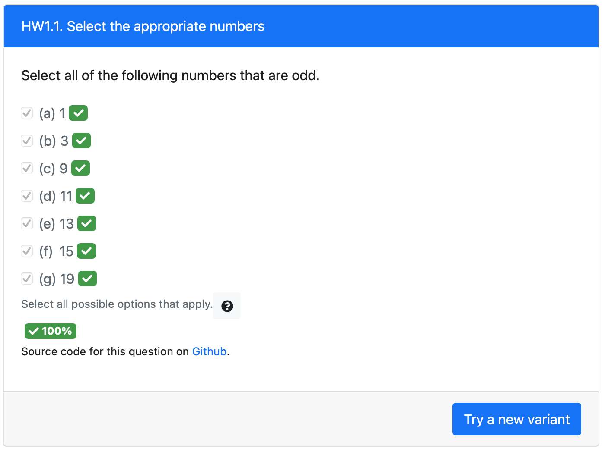
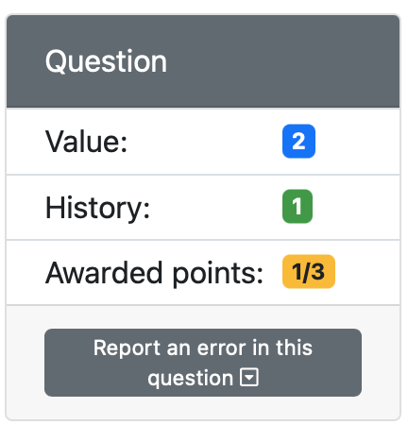
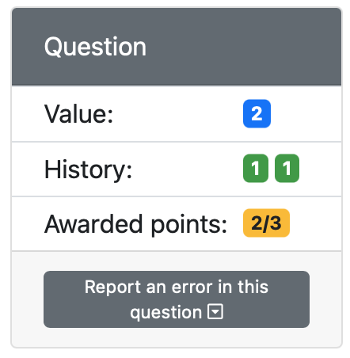
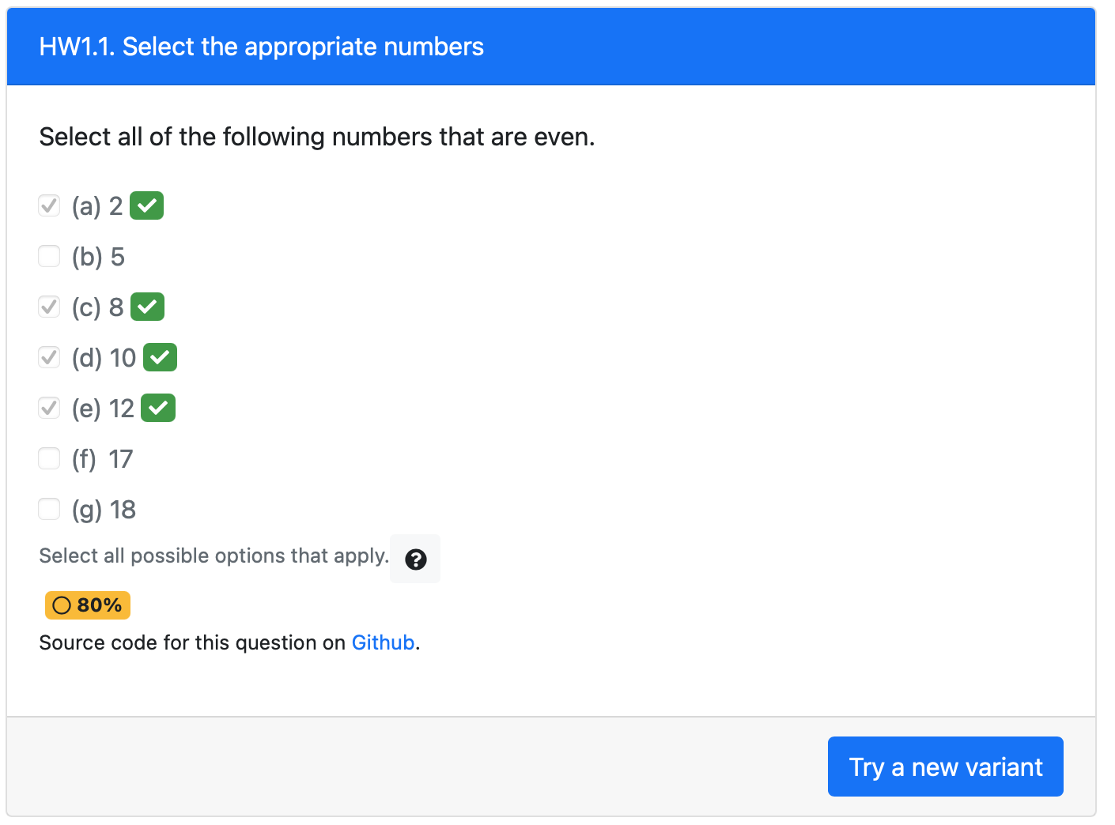
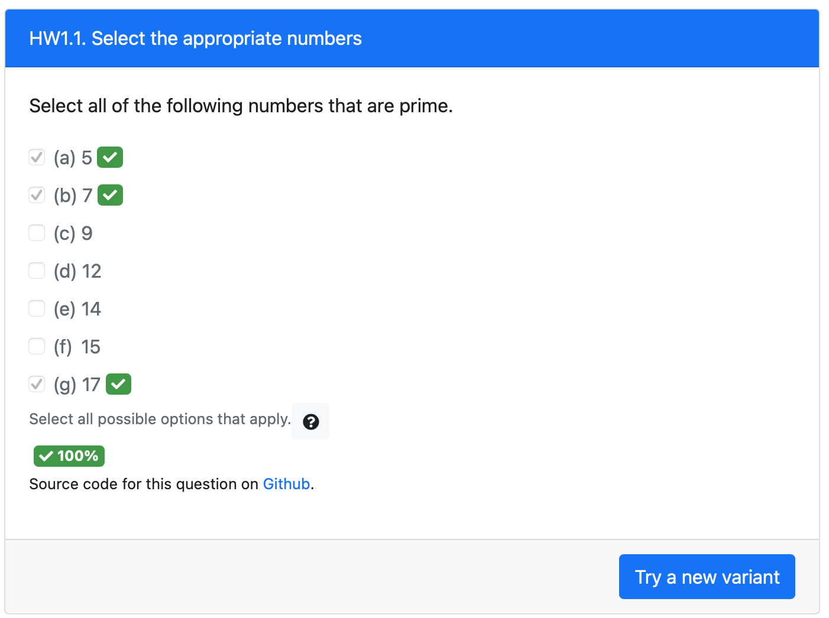
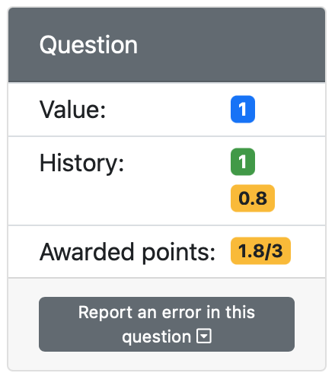
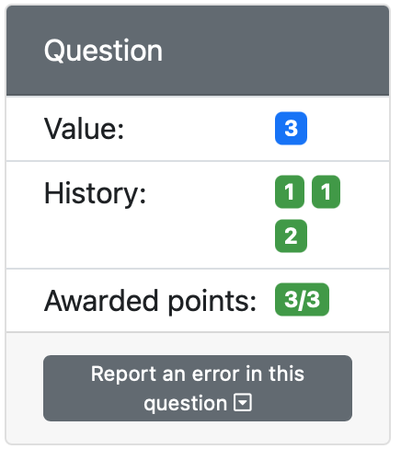
1st attempt
3rd attempt
Correct attempt completes the previous attempt that was still in-progress
This checkbox element uses a grading scheme with partial score
2nd attempt
4th attempt
Partial credit given to this attempt
Submission attempt still ”in-progress” (hence the yellow background). The next submission attempt will try to improve this score.

Slide 13
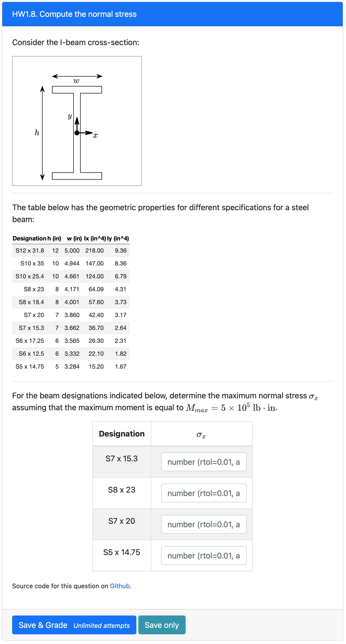
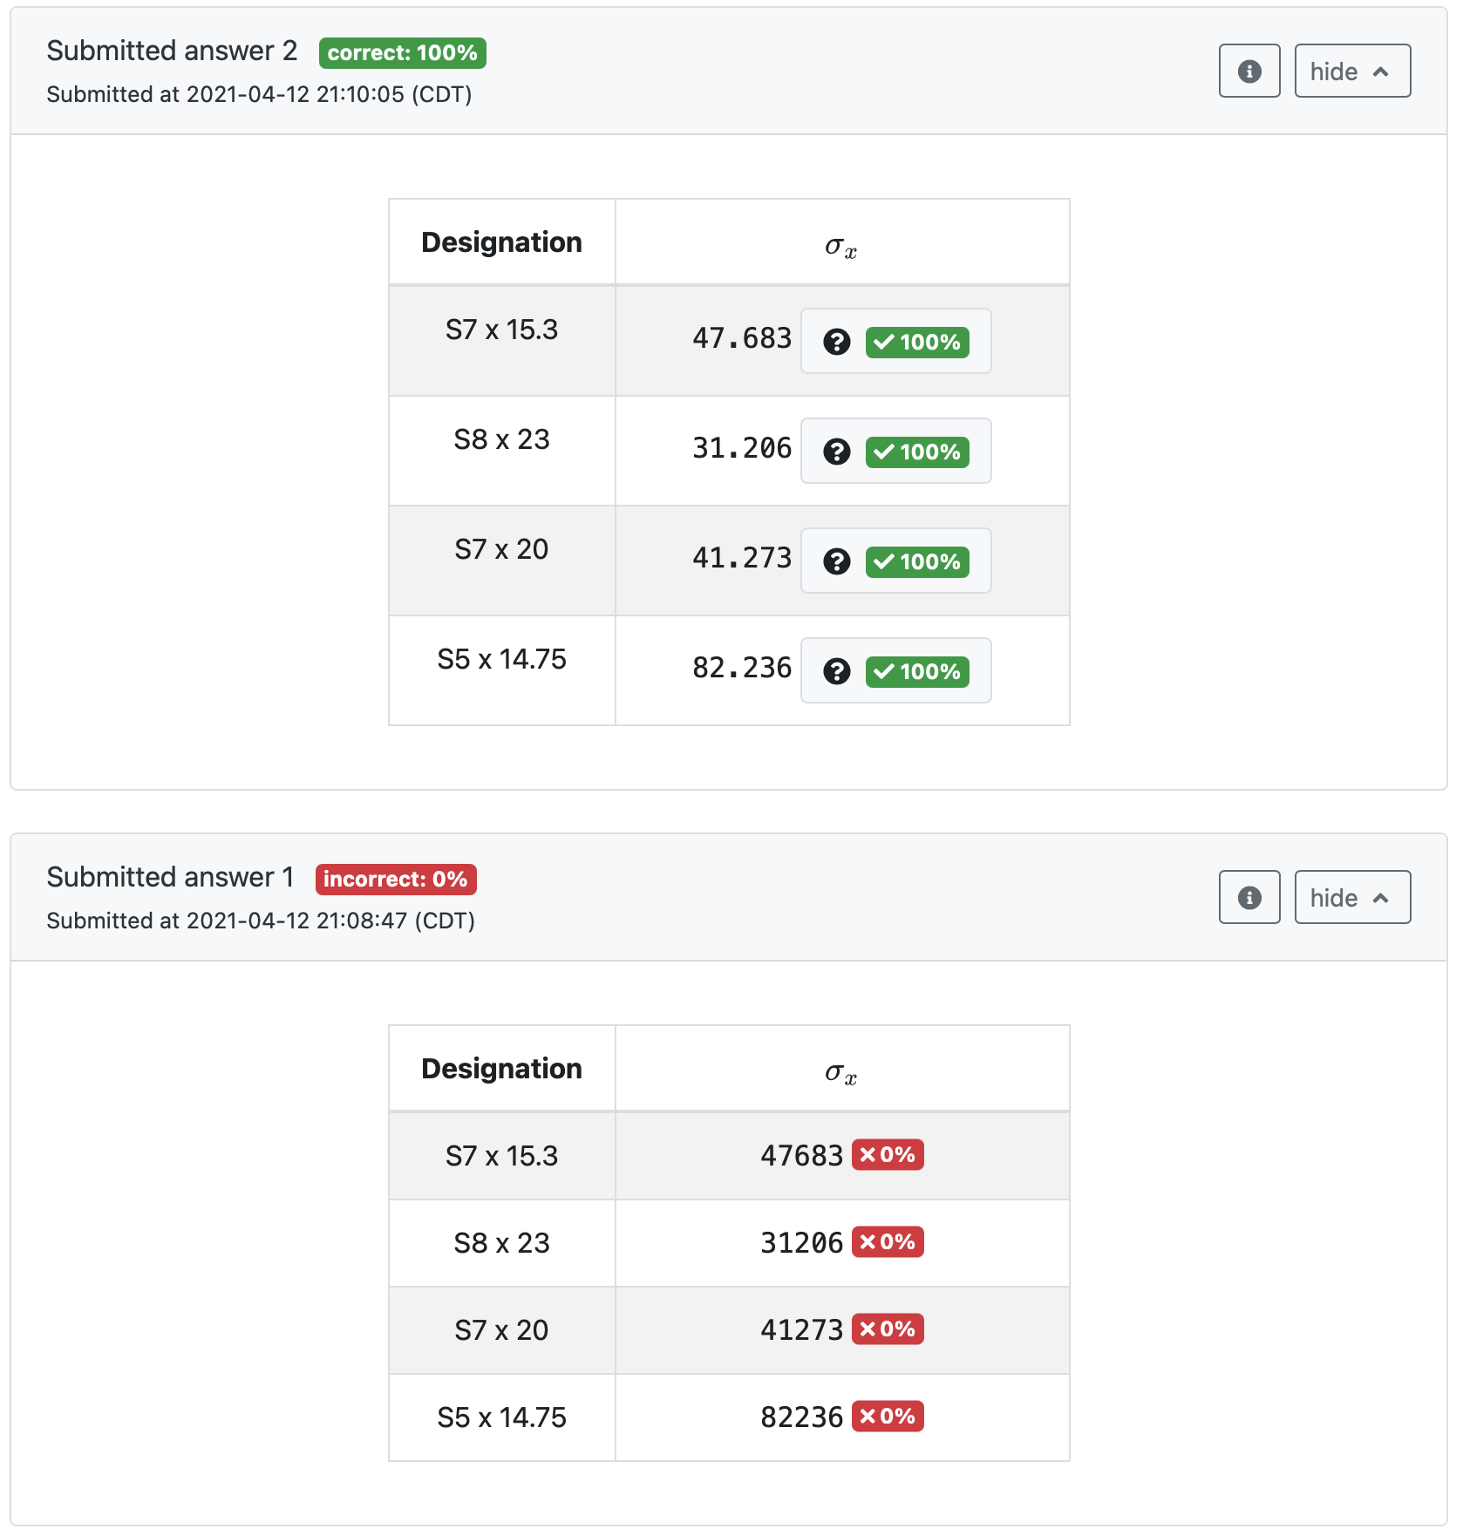
First attempt with incorrect answers (incorrect unit)
These parameters are randomized for each question variant, but with “singleVariant”: “true” they remain fixed for all unlimited attempts
Second attempt for the same question variant with the correct answers

Slide 14
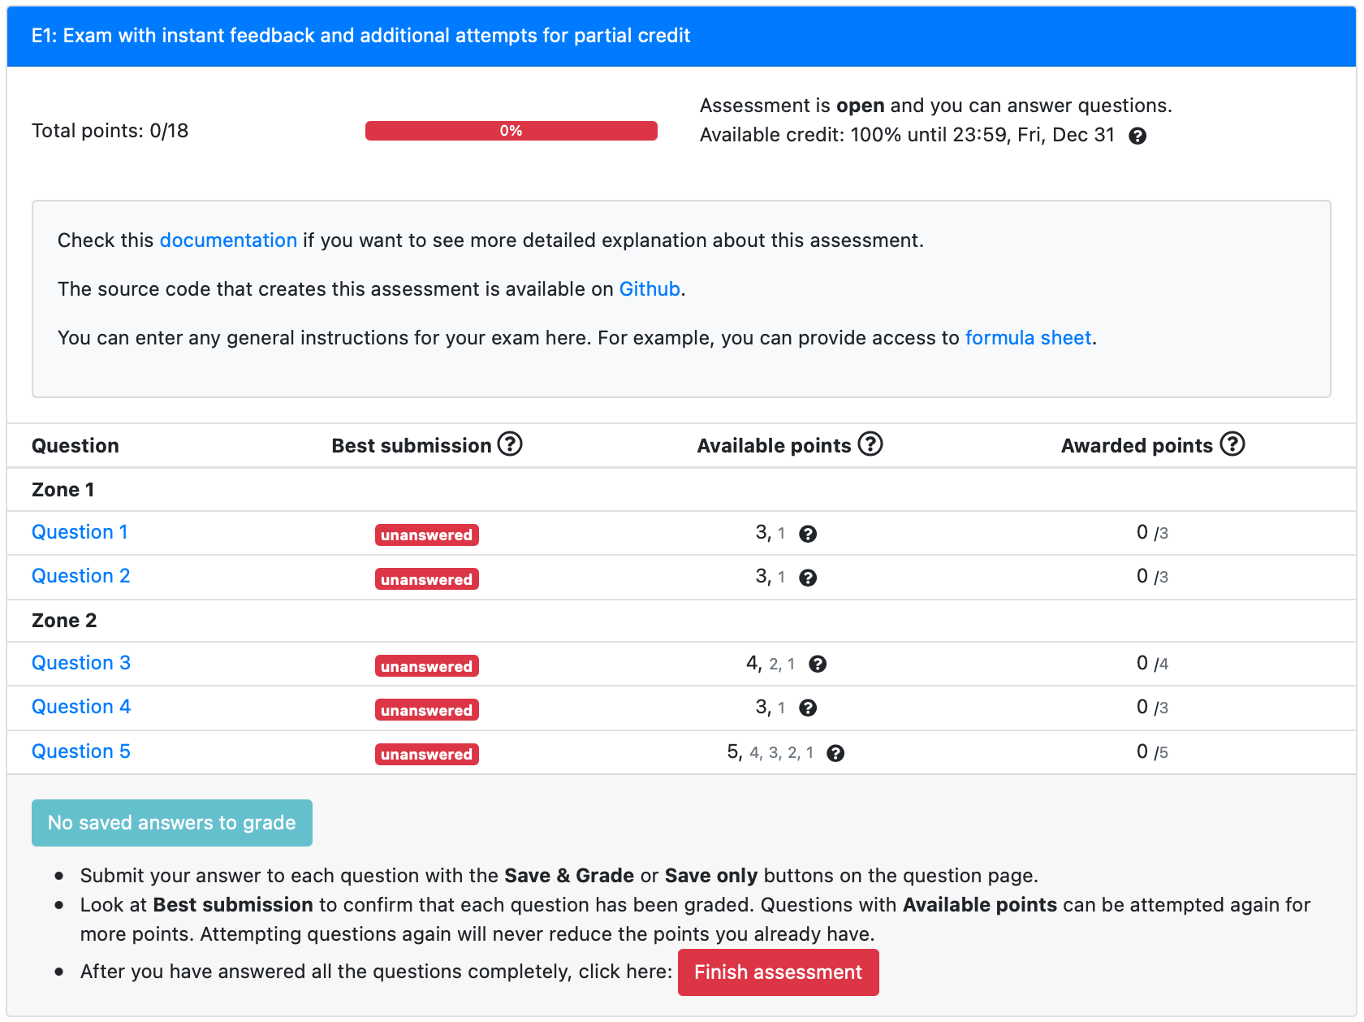
{"id": "General/mathNumberInput”}
"alternatives": [
{"id": "General/mathNumbersConcept-odd"},
{"id": "General/mathNumbersConcept-even"},
{"id": "General/mathNumbersConcept-prime"}
]
Questions are shuffled within each zone
"alternatives": [
{"id": "General/mathOuterProduct"},
{"id": "General/mathMatrixMult"},
{"id": "General/mathMatrixMultT"}
]
{"id": "General/graphAdjacencyMatrix”}
{"id": "General/engCircuit"}

Slide 15
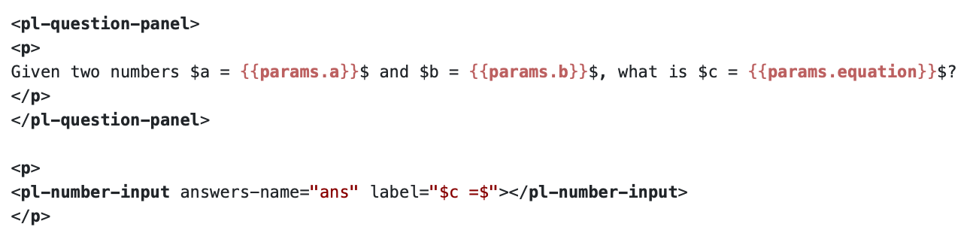
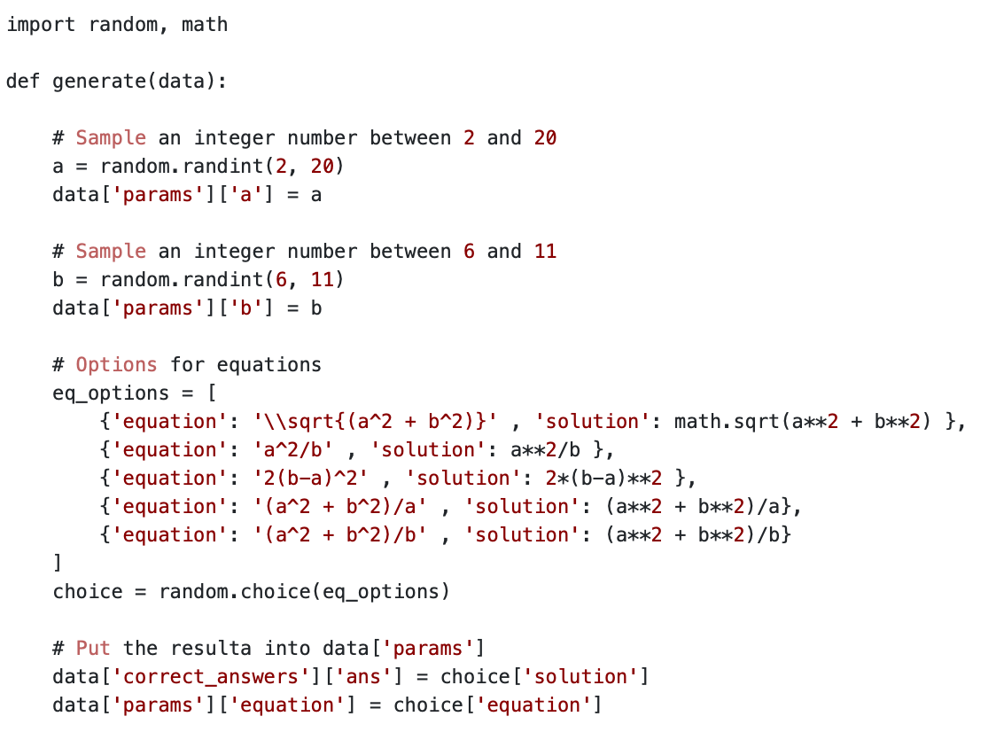
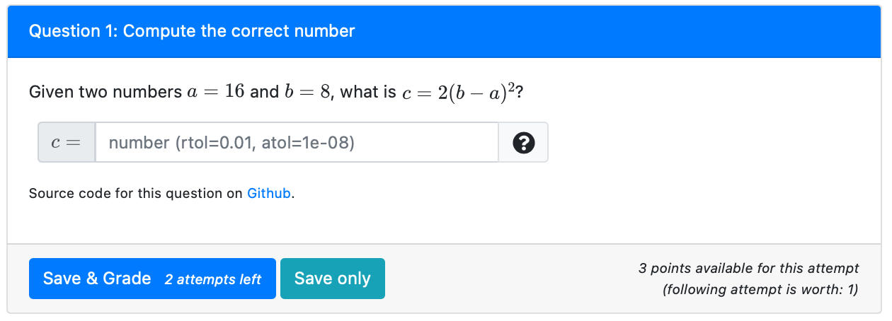
question.html
server.py
Student View
All input parameters are randomized, including the given equation for “c”

Slide 16
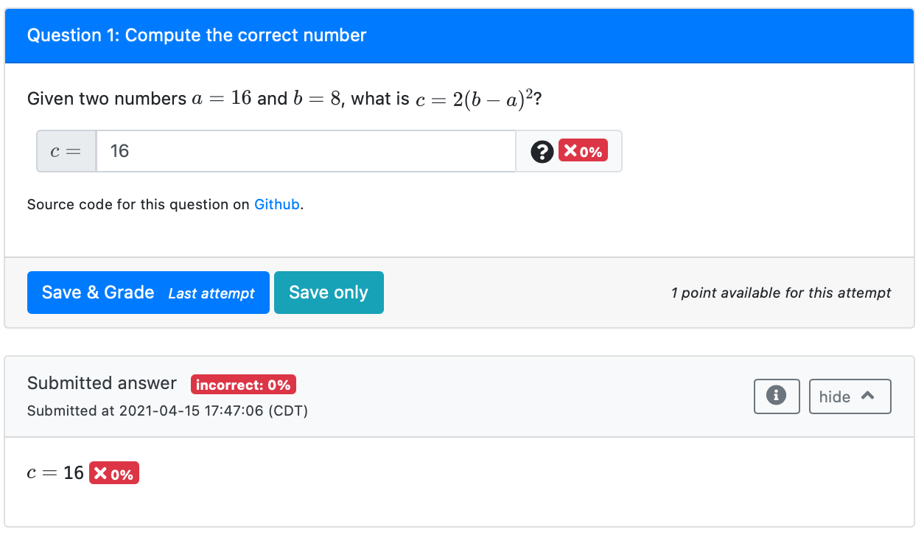
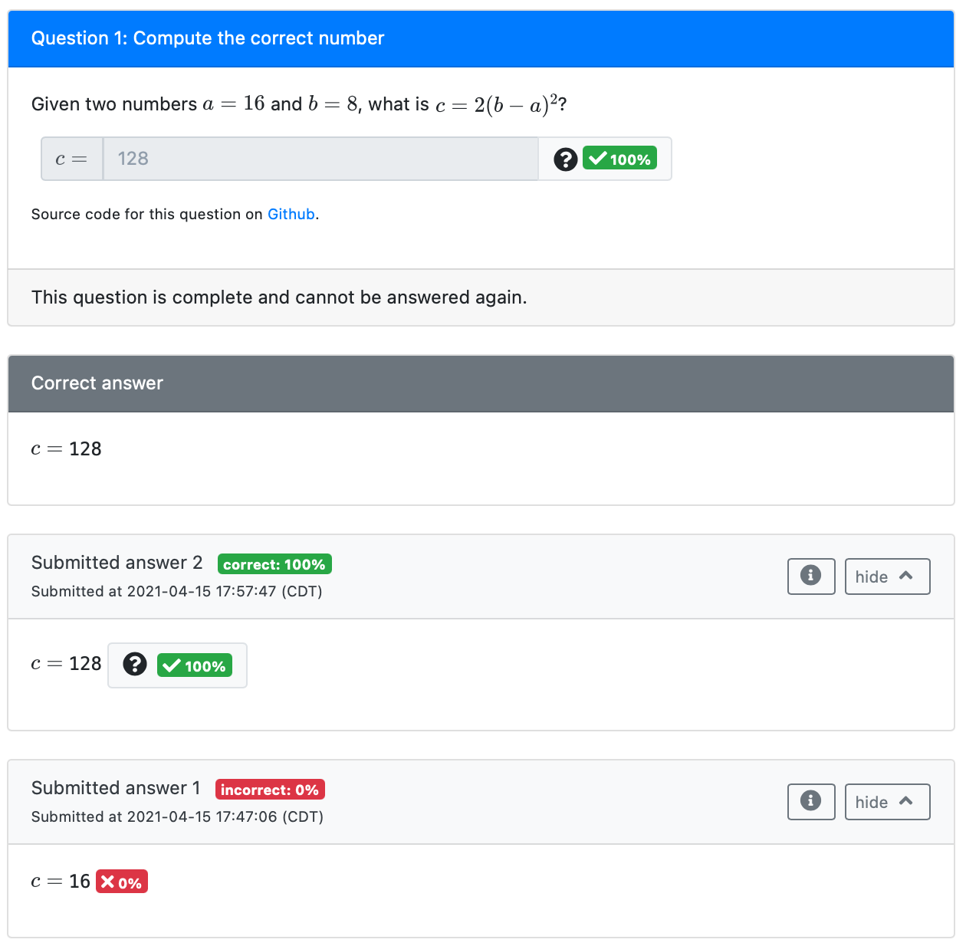
Student view after 1st attempt
Student view after 2nd (and last) attempt
Same parameters for second submission
Correct answer is shown by default when there is no attempt left, or the correct answer is achieved.
One attempt remaining for 1 point

Slide 17
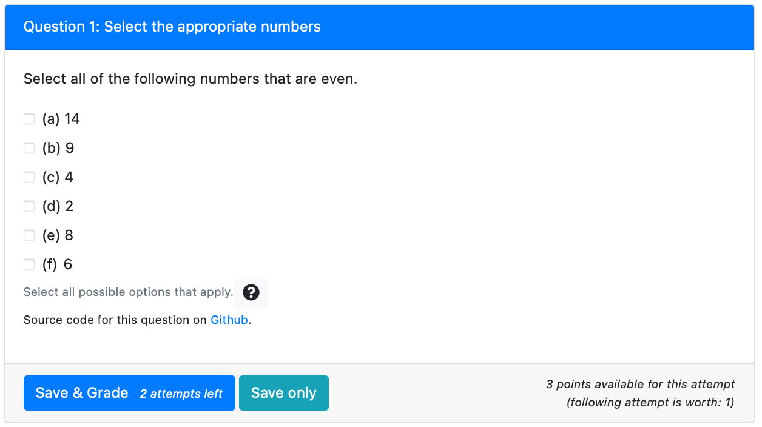
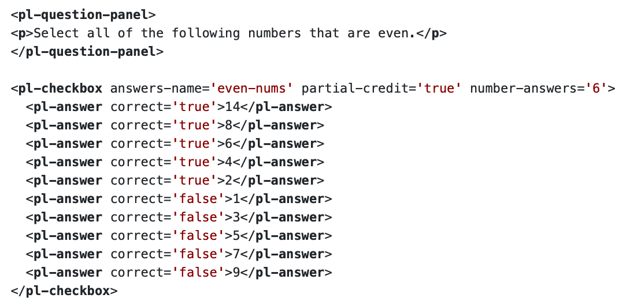

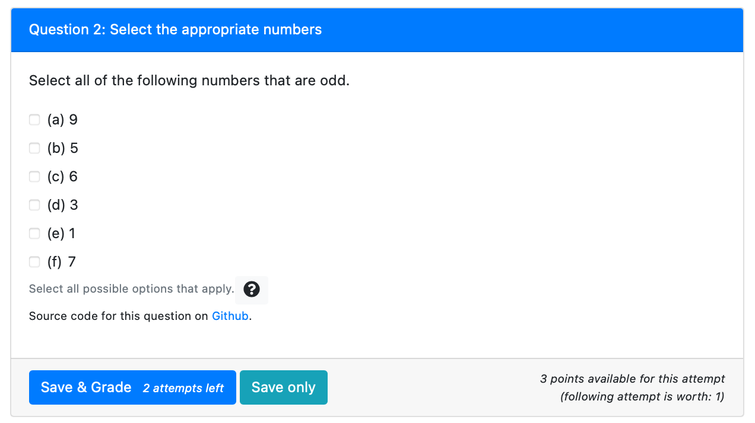
{"id": "General/mathNumbersConcept-even"}
question.html
{"id": "General/mathNumbersConcept-prime"}
{"id": "General/mathNumbersConcept-odd"}

Slide 18
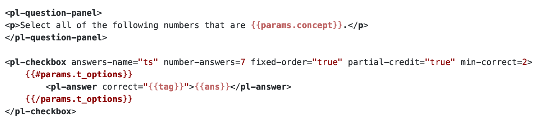
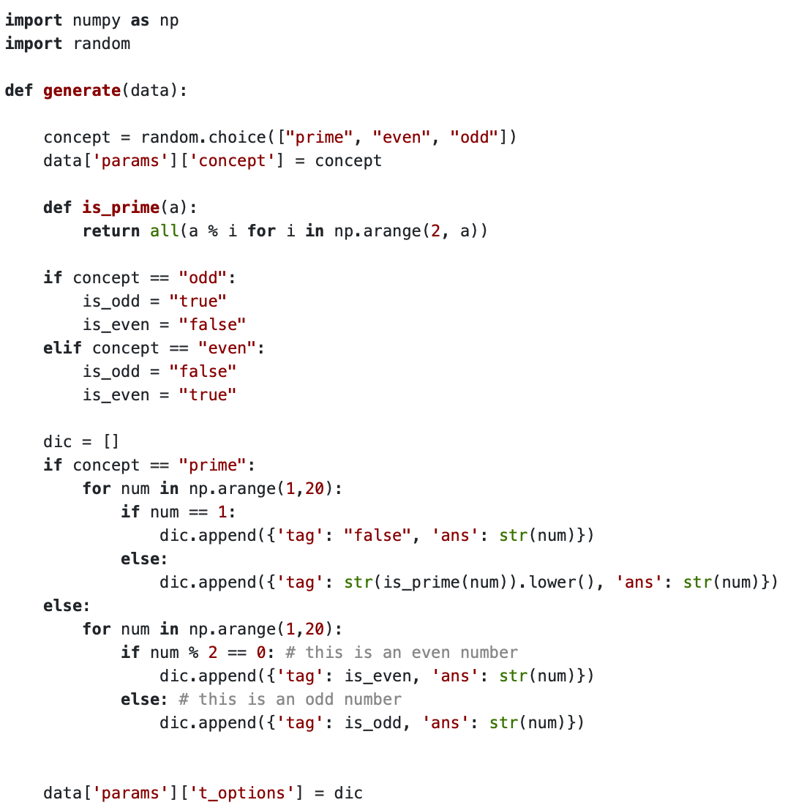
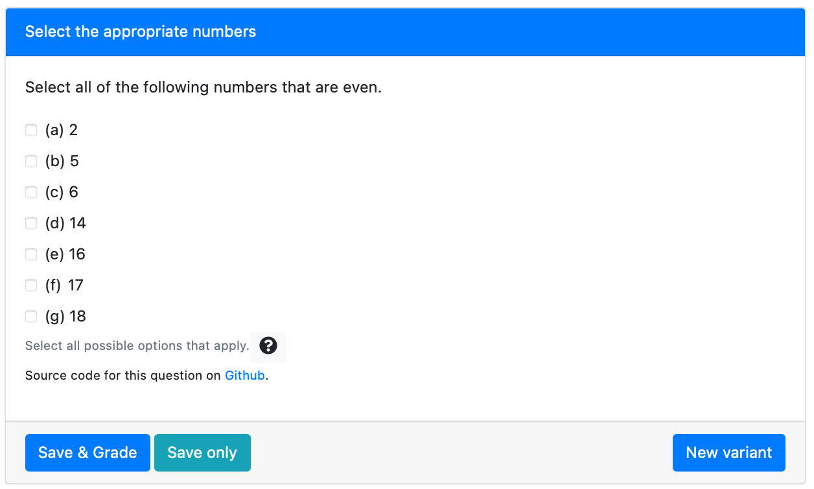
question.html
server.py
Student View

